Slide 1



Bearable
Symptom Tracking
ALL HEALTH TRACKING IN ONE PLACE. GET THE FULL PICTURE

Slide 2
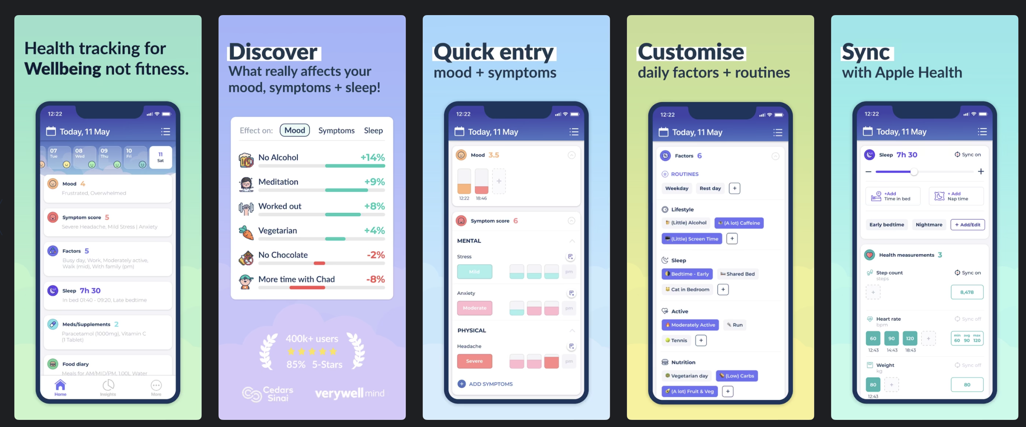

Slide 3
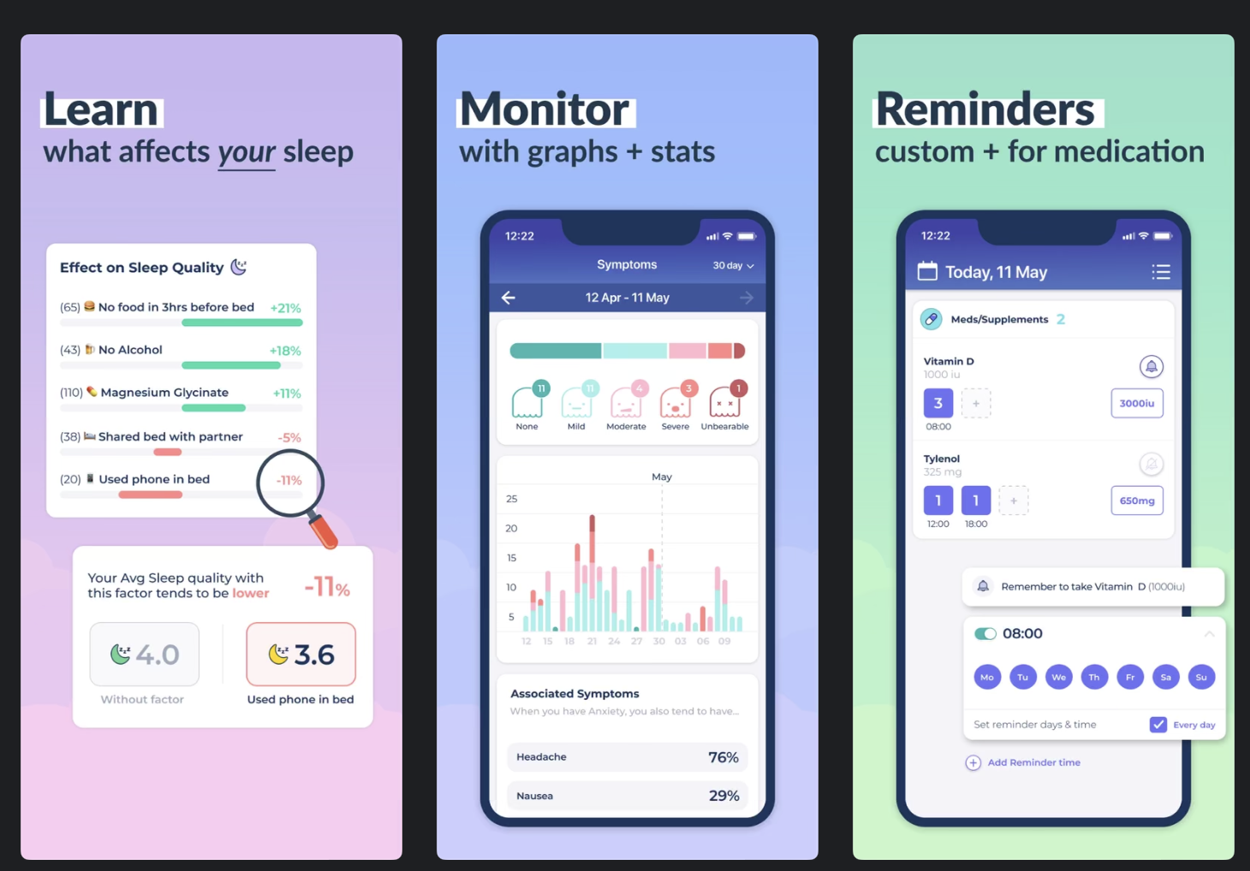

Slide 4
Future Developments
Insights to alert users – This application would benefit from the usage of alerts if the user is entering information that is starting to trend to be quite negative. This ensures that the symptoms do not worsen, and it can be treated.
HRV Status – One feature that Garmin, a fitness brand) excels at is measuring sleep. It can measure your Heart Rate Variability (HRV) to provide better information about your body; e.g. how much stress you are under by looking at beat to beat variations of your heart overnight.

Slide 5
Potential Ethical Issues
Confidentiality – Providing information through this application results in further data access and transfer. Specialists will be transferred data from Bearable to their own data center.
Increasing the paywall – There is nothing stopping Bearable increasing the cost of the application in which it could cause psychological damage to the users as they change the access to paid only users for some functionality that was initially free

